Slide 1
Planning and risk in navigation

Slide 2
Background (1)
Good navigation requires planning
Planning is becoming a central topic (again)
Good planning is an unresolved problem

Slide 3
Rationale (1)
Planning is modular
There is a difference between planning a novel action and reproducing an habit
We can calculate the cost of
a novel plan vs. an association

Slide 4


Rationale (1)

Slide 5

Rationale (1)

Slide 6
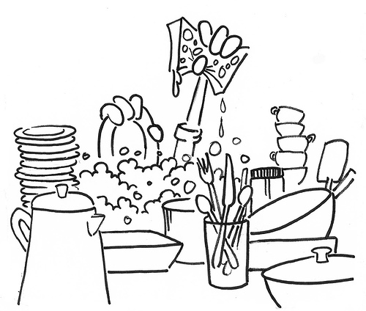
Rationale (1)
Option 1

Slide 7

Rationale (1)
Option 1

Slide 8

Rationale (1)
Option 1

Slide 9

Rationale (1)
Option 2

Slide 10
Proposal (1)
1-1
1-2
1-3
2-1
2-2
2-3
Association: 1-1 to 1-2 to 2-3
Best option: 1-1 to 2-2 to 1-3
(combination never used before)

Slide 11
Background (2)
One approach for planning is HRL
HRL applies the “split-and-conquer” strategy to reduce the cost of learning
Criteria on how to build this hierarchy is unresolved

Slide 12
Rationale (2)
A unique criteria for planning in HRL models
“Bottle-necks”

Slide 13
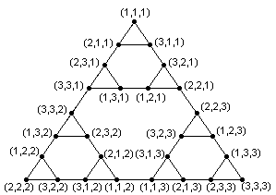
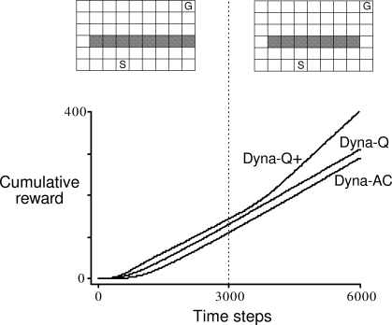
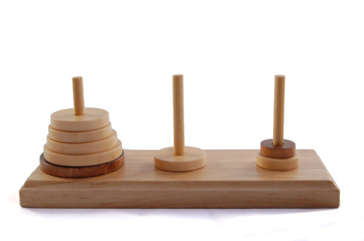
Rationale (2)

Slide 14
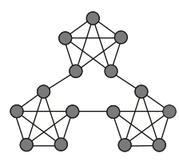
Proposal (2)
Key stations

Slide 15
Background (3)
Risk should also be important since we don't know everything
Exploration / Exploitation trade-off
Deadlines

Slide 16
Rationale (3)
Bigger variance means more possibilities
i.e., a bigger span between min and max
The optimal risk depends on the criterium to “win”

Slide 17
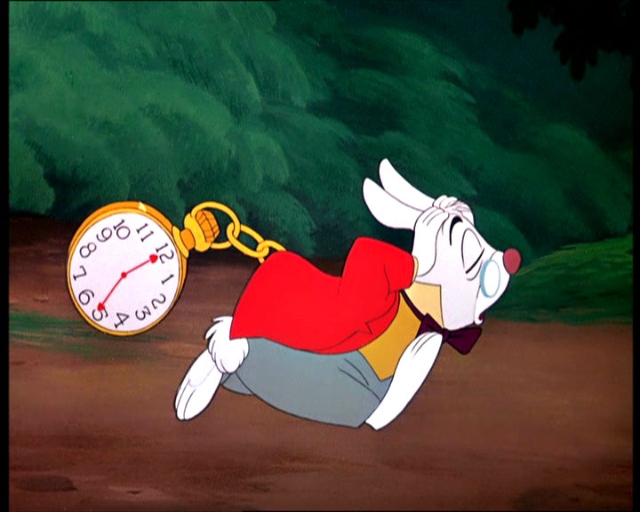
Rationale (3)

Slide 18
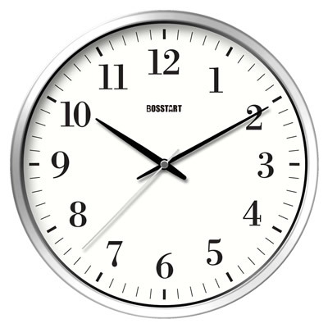
Proposal (3)
Reward-based deadlines

Slide 19
Proposal
Navigating in a subway shows all of it!

Slide 20
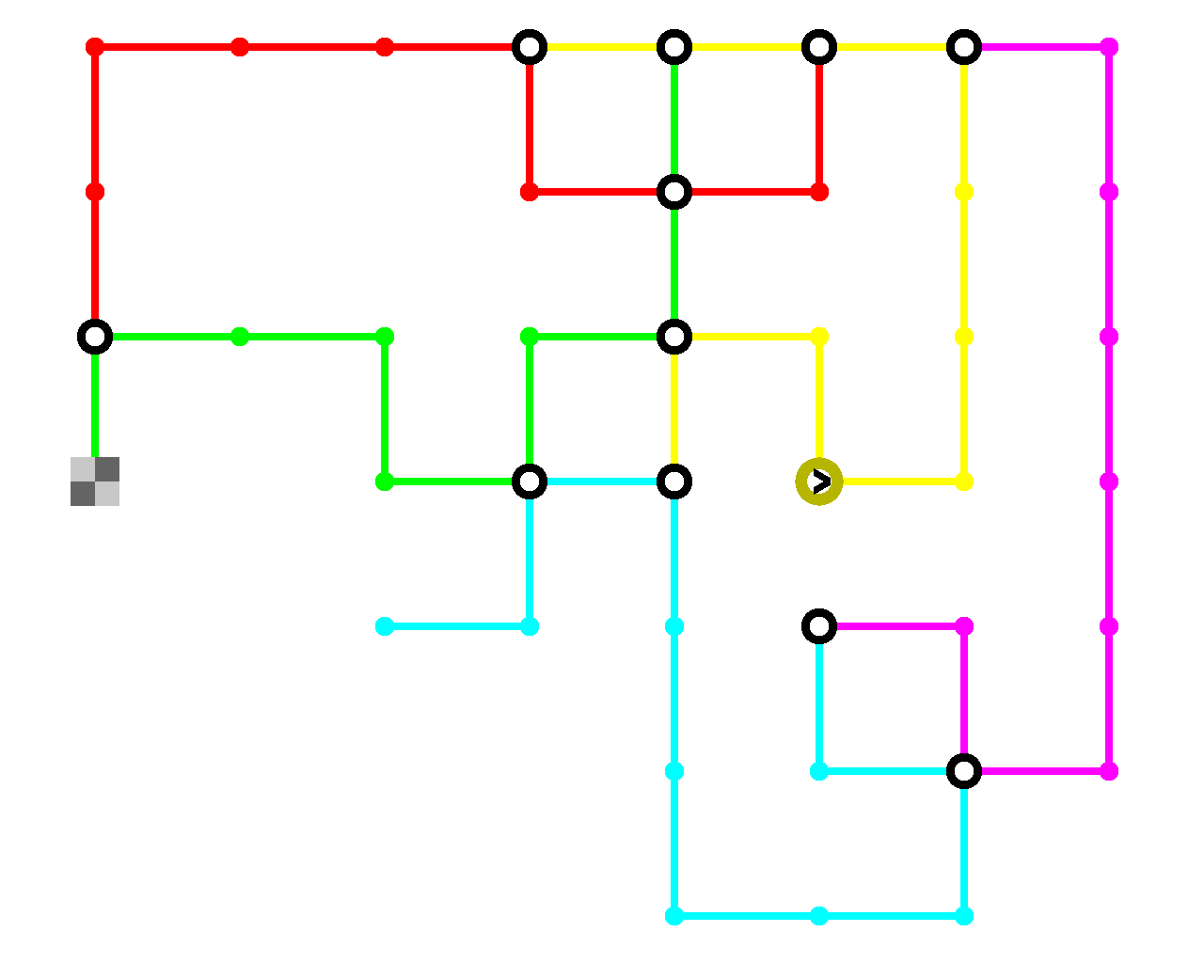
Task
goal
destination
start

Slide 21
Task
fast
slow

Slide 22
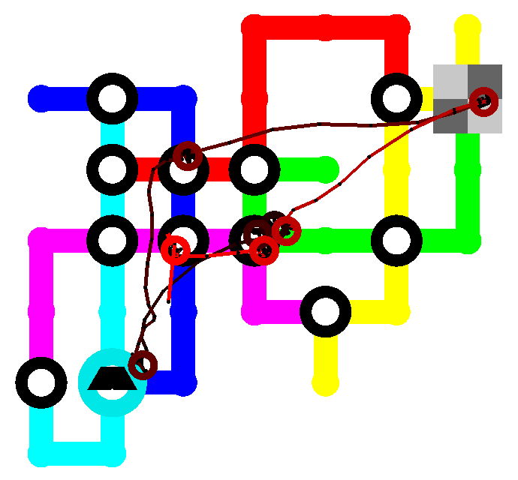
Task
fast
slow

Slide 23
Predictions
The switching point between planning and using habitual actions should have a difference in time (that is, the planning cost)
We could validate key -bottleneck- stations using eye fixations. Models can also exploit this strategy to improve HRL
Optimal planning might be risky in uncertain situations

Slide 24
This is it !

